Slide 1
CS 6360: Advanced Artificial Intelligence Lecture 8 MCTS: UCT – Game of Hex Constraint Satisfaction Problems (CSPs)
Gautam Biswas
Spring 2017

Slide 2
Outline of Lecture
Monte Carlo Tree Search
Review
Assignment 2
Game of Hex
Constraint Satisfaction Problems (CSPs)

Slide 3
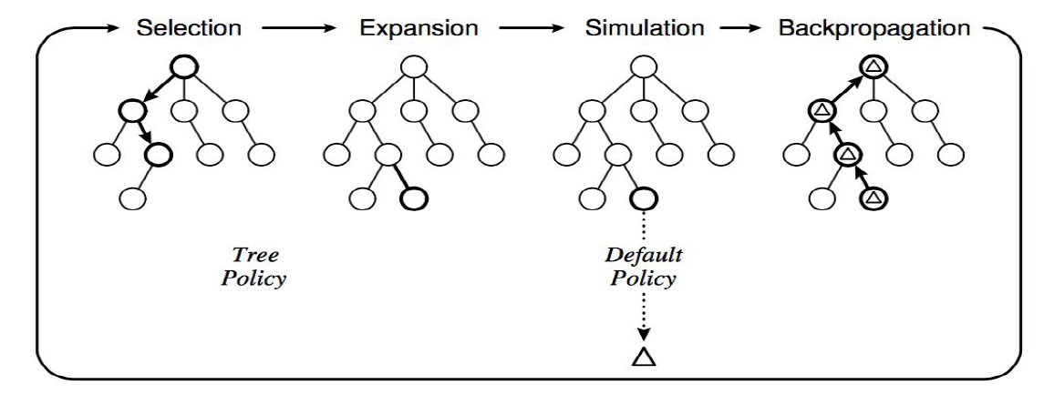
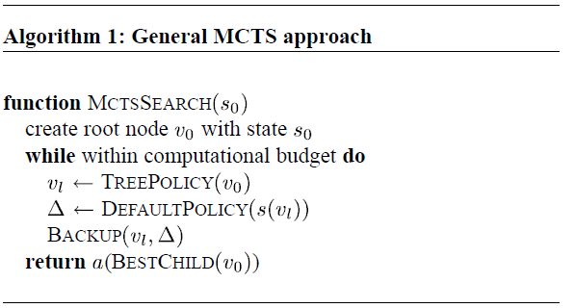





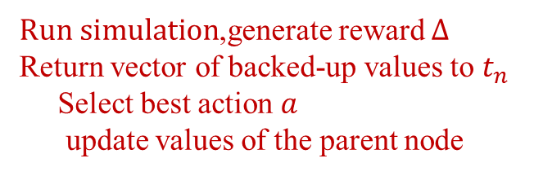


MCTS Algorithm
$$t_{0}$$
$$t_{n}$$
$$t_{n}$$
$$t_{l}$$
$For each node, store$
reward value, number of visits
$t_{0}$ to $t_{n}$ : choose using utility fn
${apply action a: t}_{n}$ to $t_{l}$ (expansion)
$Run simulation$,generate reward $Δ$
Return vector of backed-up values to $t_{n}$
Select best action $a$
update values of the parent node

Slide 4
Policies
Important
Tree policy
Used to determine how children are selected
Default policy
Used to determine how simulations are run (ex. randomized)
Result of simulation used to update values

Slide 5
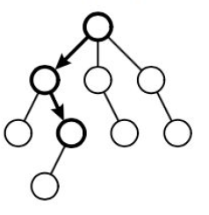
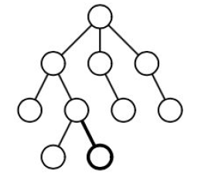
Steps
Selection
Start at root node
Based on Tree Policy select child
Apply recursively - descend through tree
Stop when expandable node is reached
Expandable -
Node that is non-terminal and has unexplored children
Expansion
Add one or more child nodes to tree
Depends on what actions are available for the current
position
Method in which this is done depends on Tree Policy

Slide 6
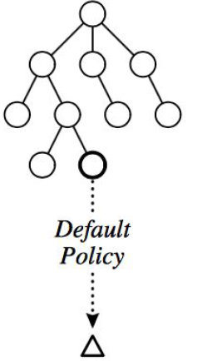
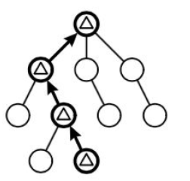
Steps (contd. ..)
Simulation
Run simulation of path that was selected
Get position at end of simulation
Default Policy determines how simulation is run
Board outcome determines value
Backpropagation
Moves backward through saved path
Value of Node
representative of benefit of going down that path from parent
Values are updated dependent on board outcome
Based on how the simulated game ends, values are updated

Slide 7
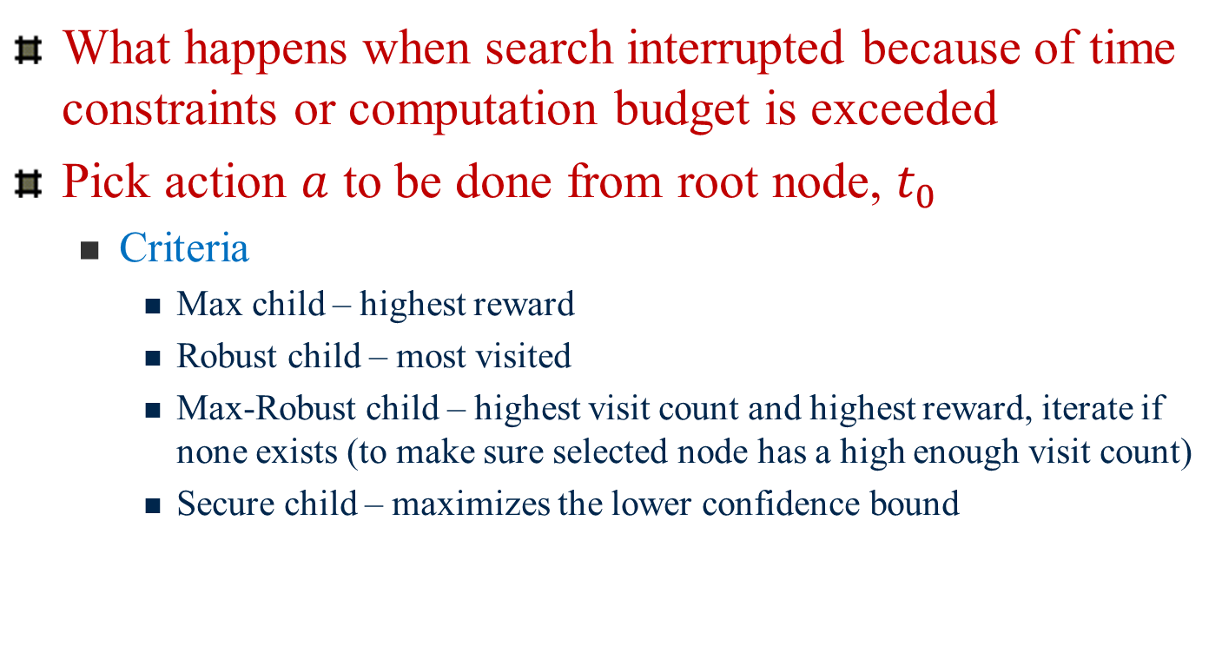
MCTS algorithm
What happens when search interrupted because of time constraints or computation budget is exceeded
Pick action $a$ to be done from root node, $t_{0}$
Criteria
Max child – highest reward
Robust child – most visited
Max-Robust child – highest visit count and highest reward, iterate if none exists (to make sure selected node has a high enough visit count)
Secure child – maximizes the lower confidence bound

Slide 8
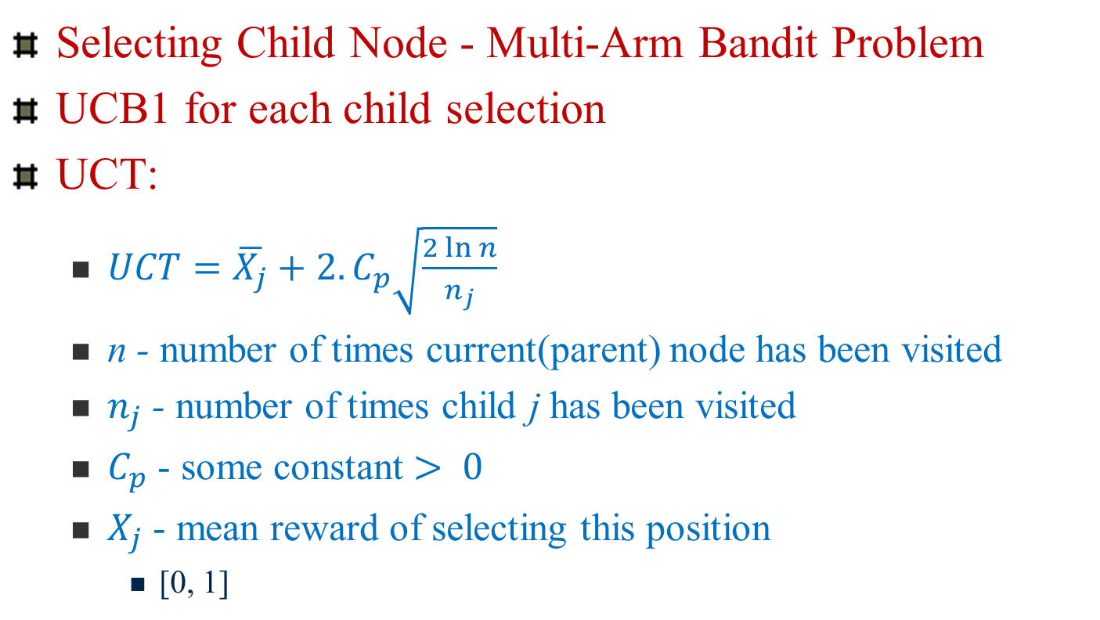
UCT Algorithm
Selecting Child Node - Multi-Arm Bandit Problem
UCB1 for each child selection
UCT:
$UCT=\overline{X_{j}}+2.C_{p}\sqrt{\frac{2\ln{n}}{n_{j}}}$
n - number of times current(parent) node has been visited
$n_{j}$ - number of times child j has been visited
$C_{p}$ - some constant $> 0$
$X_{j}$ - mean reward of selecting this position
[0, 1]

Slide 9
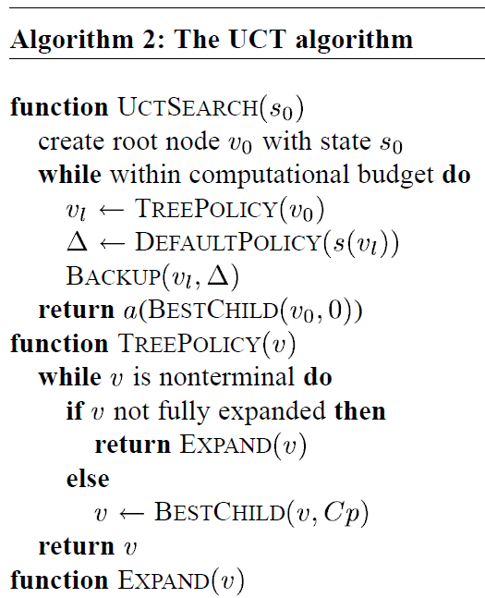
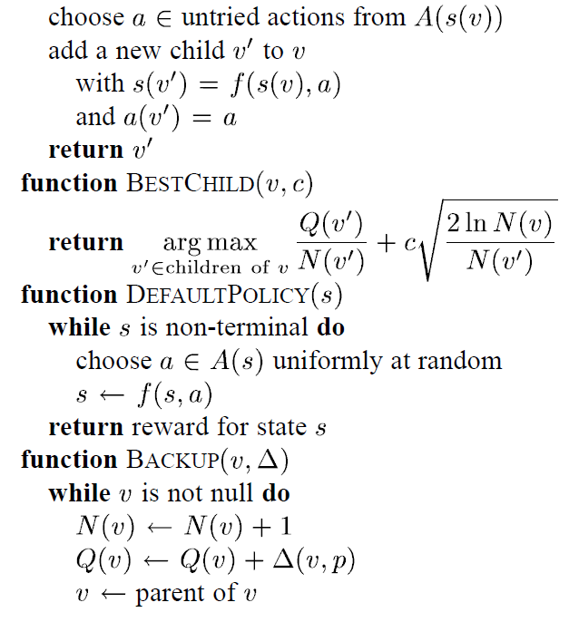
UCT Algorithm

Slide 10
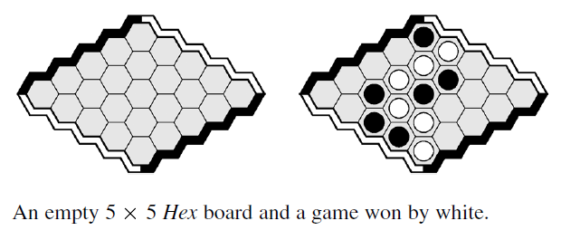
Game of Hex
Black & White alternate; player places single piece of their color on board/turn
Winner: forms a chain between two opposing board sides
First player has advantage (extra piece on board first)
Therefore, use swap rule

Slide 11
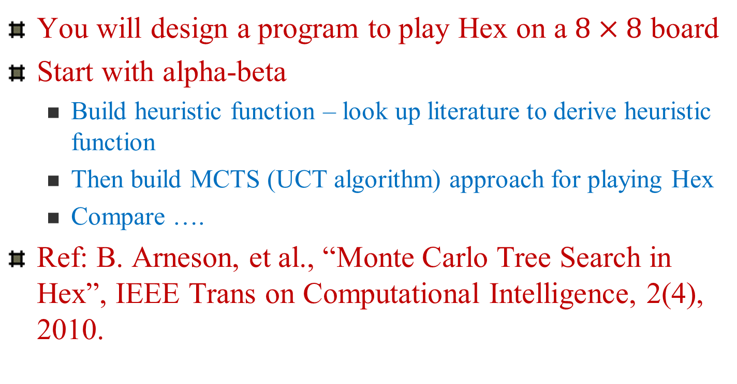
Assignment 2
You will design a program to play Hex on a $8×8$ board
Start with alpha-beta
Build heuristic function – look up literature to derive heuristic function
Then build MCTS (UCT algorithm) approach for playing Hex
Compare ….
Ref: B. Arneson, et al., “Monte Carlo Tree Search in Hex”, IEEE Trans on Computational Intelligence, 2(4), 2010.

Slide 12
Program specifications
Allow human vs computer or computer vs computer play
You will have to think about
Heuristic evaluation functions
Expansion policy
Tree search
Default (Simulation)
How to pick the most promising nodes?
Report statistics
Depth of search/simulation
Number of simulations performed
Max size of search tree

Slide 13
Program specifications
Alpha-Beta search
Heuristic evaluation function
Cut offs applied
Dead end searches
Inferior cell analysis
Mustplay results
Fill in procedures

Slide 14
Constraint Satisfaction Problems
Reference
R. Bartak, “Constraint Propagation and Backtracking-Based Search,” Tech. Report, Charles Univ., Czech Republic.

Slide 15
Constraint Satisfaction Problems
Constraint Satisfaction Problem (CSP)
Set of Variables: {X₁, X₂, X₃, … X_{n}}
Set of Constraints: C₁, C₂, … C_{m}
Each X_{i} has a non-empty domain D_{i} of possible values, v_{i}.
{D₁, D₂, … D_{n}}
Each C_{i} = <scope, rel>; scope: tuple of variables that participate in constraint; rel: relation that defines the values those variables can take on
Implies the combination of v_{i}’s that the subset of variables can take

Slide 16
Constraint Propagation
Constraints
Linear, Nonlinear
Discrete, Continuous
Unary, Binary, …., Global (involving arbitrary number of variables)
Solution to CSP cannot violate any of the specified constraints
Other types of constraints
Preference

Slide 17
CSPs as Search Problem
Incremental formulation
Initial state: { }
Successor function: value assigned to unassigned variable, such that it does not conflict previous assignments
Goal test: current assignment is complete
Path cost: constant cost (e.g., 1) for every step

Slide 18
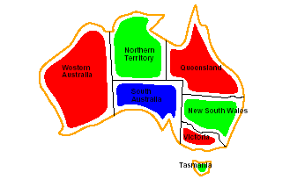
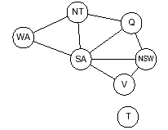
Map Coloring – one solution
Constraint
Graph
Formulation of CSP as a constraint graph – each node is a variable,
links are constraints.
Some observations: exploit properties of graph structure to speed up
solution, e.g., T independent problem from rest of graph
What would be the constraint graph for the 4-queens problem?

Slide 19
Solving CSPs
Backtracking Search
Depth-first search that chooses values for one variable at a time and backtracks when a variable has no legal values left to assign
DFS that chooses values for one variable at a time and backtracks when a variable has no legal values left to assign is a backtracking search.
Why good?
Problem is commutative, i.e., order of application of actions has no effect on outcome

Slide 20
Backtracking Search
WA = red
WA = green
WA = blue
WA = red
NT = green
WA = red
NT = blue
WA = red
NT = green
Q = red
WA = red
NT = green
Q = blue

Slide 21
Backtracking: Disadvantages
Thrashing – repeated failure for same reason
Solution: Backjumping or Intelligent Backtracking: identify the conflicting value of variable
Redundant Work – conflicting values are not remembered
Solution: Backchecking or Backmarking (Dependency-directed backtracking)
Detects conflicts too late – detects only when conflict occurs
Forward Checking, Constraint Satisfaction
First, let’s look at variable and value ordering

Slide 22
How do we combine MRV, Degree Heuristic, & LCV
MRV – better than random search in picking which variable to assign next
Does not help in making the initial decision
Degree heuristic most useful for initial decisions on what variable to chose for assignment & later for tie-breaking
LCV – helps in assigning value to a variable – leave max flexibility for subsequent assignments
Note: MRV is fail-first; LCV is fail-last
MRV helps prune large amounts of search tree
LCV useful in getting to a solution fast

Slide 23
Propagation of Constraints
Can we reduce the search space by propagating constraints themselves, so we can catch inconsistencies earlier in the search process?
Forward Checking
Constraint Propagation

Slide 24

Forward Checking
When variable $X$ is assigned, check each unassigned variable Y connected to $X$ by a constraint.
Delete from Y’s domain any value that is inconsistent with the value assigned to $X$.

Slide 25
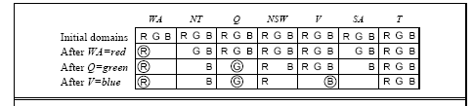
Constraint Propagation
{B}
Propagate the implications of a constraint on one variable onto other variables locally
Must be able to do this quickly.
Why? Because purpose is to speed up search
Q
WA
{ }
{B}
V
Arc consistency

Slide 26
Node Consistency
A CSP is node consistent if all its variables are node consistent
Unary Constraints
Check constraints that apply to a particular node or variable
e.g., WA≠ G; V ≠ B

Slide 27
Arc Consistency
Arc $(V_{i},$ $V_{j}$) is arc consistent, if $∀v_{ik}∈V_{i}$ which satisfies constraints associated with $V_{i}$
$∃$ $v_{jm}∈V_{j}$ such that $v_{ik}$ and $v_{jm}$ satisfy the binary constraint between $V_{i} and V_{j}$
Note that arc consistency is directional
$(V_{i},$ $V_{j}$) is consistent does not mean $(V_{j},$ $V_{i}$) is consistent
A CSP is arc consistent $⇔every Arc (V_{i},$ $V_{j}$) in its constraint graph is Arc consistent

Slide 28
Arc Consistency
Fast method for Constraint propagation
Introduce directed arcs in the constraint graph.
Arc is consistent iff for every value on source side has a consistent value on destination side
If node X looses a value, check neighbors of X
Provides early detection of inconsistencies.
Must be applied repeatedly to detect ALL constraints.
Preprocessing step – before beginning of search
Propagation step (like forward checking) : use a queue to keep track of all variables that need to be checked
Apply repeatedly

Slide 29
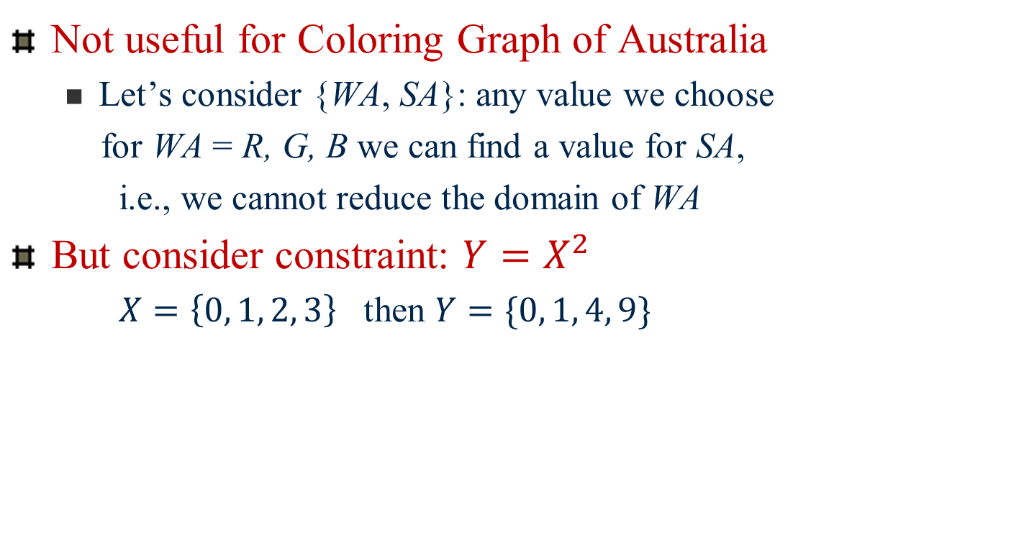
Arc Consistency
Not useful for Coloring Graph of Australia
Let’s consider {WA, SA}: any value we choose
for WA = R, G, B we can find a value for SA,
i.e., we cannot reduce the domain of WA
But consider constraint: $Y=X^{2}$
$X=\left\{0, 1, 2, 3\right\}$ then $Y=\{0, 1, 4, 9\}$

Slide 30
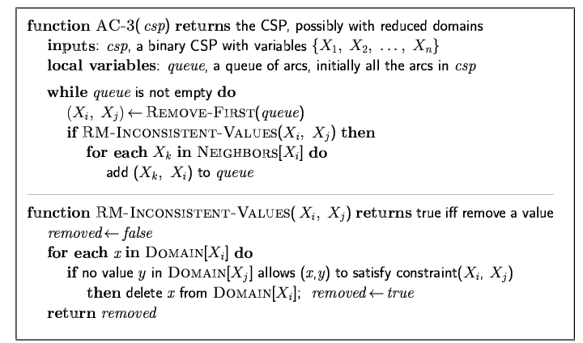
Arc consistency algorithm AC-3

Slide 31
AC-3
How exactly does arc consistency work?
Start checking all constraints between pairs of variables
If at some point variable, V_{i} constrained, go back and check all variables related to V_{i} because their values could be further constrained …. This could happen multiple times …
AC-3 based on the notion of support
Time complexity of AC-3: O(c.d³)
n variables each with domain size d; c – binary constraints
But AC-3 inefficient
When it retests edge for second time, it is retesting number of value pairs, which are not affected by dropping a value from V_{i}

Slide 32
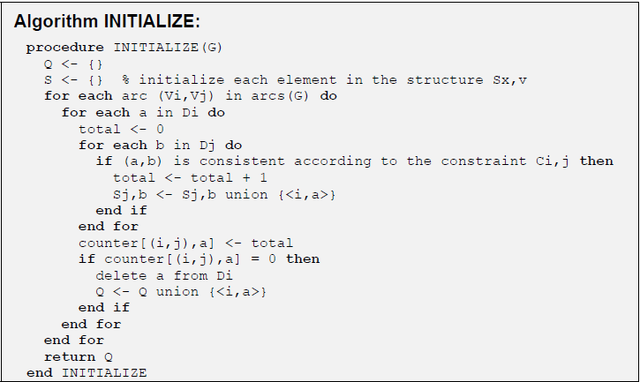
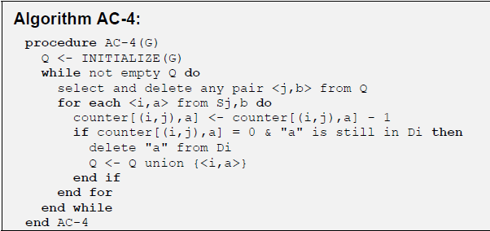
AC-4
More efficient algorithms than AC-3, e.g., AC-4 (see Bartak, page 16-17)

Slide 33
AC-4 Characteristics
Works by finding supports for individual pairs of values
INITIALIZE procedure
Internal structures used to remember pairs of consistent (inconsistent) values of incidental variables (nodes) - initialized
Structure S_{i,a} represents set of supports
Also counts “supporting” values from the domain of incidental variable & removes values that have no support
Once the value is removed from the domain, the algorithm adds the pair <variable, value> to the list Q for re-revision of affected values of corresponding variables
Re-revision is only for those pairs of variables of incidental variables that were affected in previous iteration

Slide 34
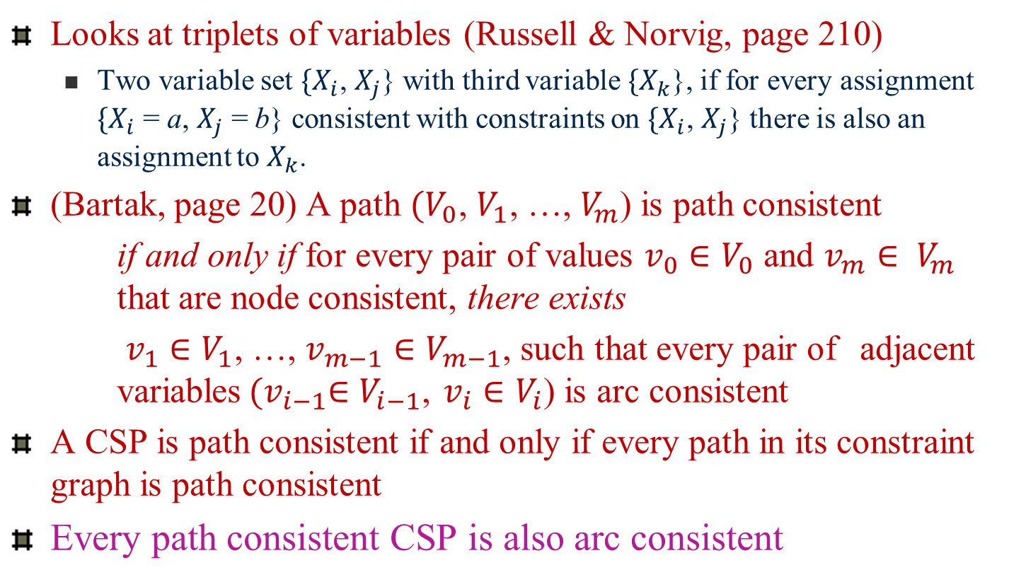
Path Consistency
Looks at triplets of variables (Russell & Norvig, page 210)
Two variable set ${\{X}_{i}$, $X_{j}$} with third variable ${\{X}_{k}$}, if for every assignment ${\{X}_{i}$ = a, $X_{j}$ = b} consistent with constraints on ${\{X}_{i}$, $X_{j}$} there is also an assignment to $X_{k}$.
(Bartak, page 20) A path $(V_{0}$, $V_{1}$, …, $V_{m}$) is path consistent
if and only if for every pair of values $v_{0}∈V_{0}$ and $v_{m}∈ V_{m}$ that are node consistent, there exists
$v_{1}∈V_{1}$, …, $v_{m−1}∈V_{m−1}$, such that every pair of adjacent variables${(v}_{i−1}∈V_{i−1}$, $v_{i}∈V_{i}$) is arc consistent
A CSP is path consistent if and only if every path in its constraint graph is path consistent
Every path consistent CSP is also arc consistent

Slide 35
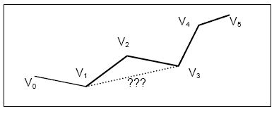
Path Consistency
Path consistent CSP is arc-consistent
Reverse is not true
(Arc consistent $⇏Path Consistent)$
CSP is path consistent iff all paths of length 2 are path consistent (see page 20, Bartak)
Matrix representation – path consistency by composition (Algorithms PC-1, PC-2, DPC)

Slide 36
Stronger forms of Constraint Propagation
Arc consistency does not detect all inconsistencies
k-consistency
CSP is k-consistent if for any set of k-1 variables and for any consistent assignment to those variables, a consistent value can always be assigned to any k^{th} variable
1-consistency: node-consistency
2-consistency: arc-consistency
3-consistency: path-consistency
Strong k-consistency
It is k-consistent , (k-1) consistent, (k-2) consistent, … all the way down to 1-consistent
This is ideal since a solution can be found in time O(nd) instead of O(n²d³)
No free lunch: any algorithm for establishing n-consistency is
exponential in n, in the worst case

Slide 37
Issues in Backtracking (BT)
Chronological – revisit most recent decision point: take alternate path (standard DFS)
Problems
Thrashing: throws away the reason of the conflict
Example: A,B,C,D,E:: 1..10, A>E; BT tries all the assignments for B,C,D before finding that A≠1
Redundant work
Unnecessary constraint checks are repeated
Example: A,B,C,D,E:: 1..10, B+8<D, C=5*E; when labeling C,E the values 1,..,9 are repeatedly checked for D
Late detection of the conflict
Constraint violation is discovered only when the values are known
Example: A,B,C,D,E::1..10, A=3*E; the fact that A>2 is discovered when labeling E

Slide 38
Backjumping (Intelligent Backtracking)
How to avoid thrashing, i.e., skip irrelevant assignments
Identify the source of the conflict (impossible to assign a value)
Violated constraint is source of inconsistency – find conflicting variable
If all values in the domain of that variable explored
then
BJ backtracks to the most recent conflicting variable

Slide 39
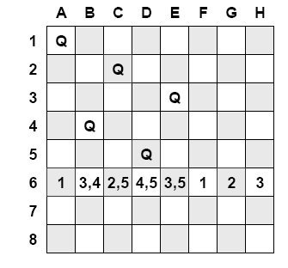
Example of backjumping
Cannot add queen to row 6
Chronological backtracking
Move queen in row 5 – does
not solve problem
Backjumping
5 not the problem
(moving 5 would not clear a
position for 6)
4 is the closest problem

Slide 40
BJ algorithm
How to find a jump position? What is the source of the conflict?
Form conflict set. Conflict set for variable X is the set of previously assigned variables that are connected to X
Backjumping: Jump to most recent variable in conflict set
Note that forward checking can supply the conflict set with no additional work
X → Y causes deletion in Y, add X to Y’s conflict set; when last value is deleted from Y’s domain, variables in the conflict set for Y added to X’s conflict set.
Simple Backjumping ≡ Forward checking

Slide 41
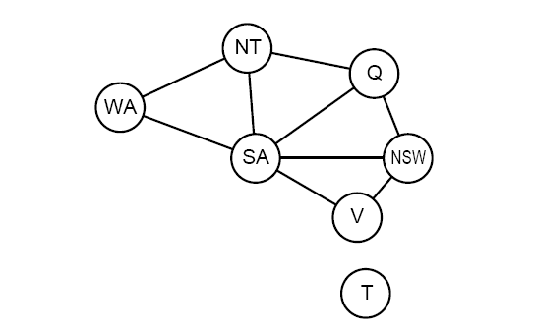
Conflict-directed Backjumping
Conflict set for variable X is the set of previously assigned variables that are connected to X by constraints
SA = {Q, NSW, V}
?
Backtrack to the most recently assigned variable in the conflict set
Note:
Every branch pruned by backjumping is also pruned by forward checking.
Back up and change the value for V
V = red; SA = blue

Slide 42
Backmarking
Backchecking – Improves on backjumping by remembering conflicts
Remember combinations of variable assignments that failed – don’t use again
Backmarking – improves backjumping – avoids rediscovery of inconsistencies + redundant constraint checking

Slide 43
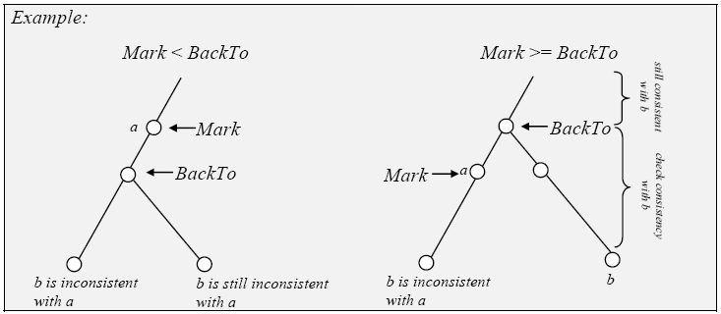
Backmarking
When extending search path by assigning value to variable X
Use variable Mark to note level where inconsistency is detected for each value of X; if no inconsistency, then Mark = level above which X assigned value
Variable BackTo – highest level to which search has backed up since the last time X was considered
When considering value V for X
Mark < BackTo
If the level at which
V failed before is
above BackTo then
V will fail again
Mark ≥ BackTo
Since we are above
we have to test V
again. But check from
level BackTo down

Slide 44
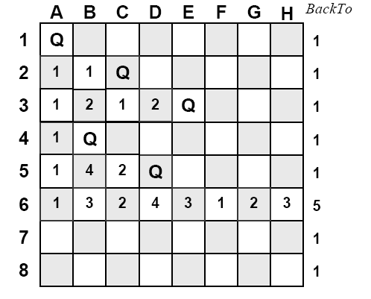
Backmarking: 8 Queens
Backing up to Level 5 does not help; set BackTo = 4 for levels 5 and 6,
continue

Slide 45
Next Class
Next Topic:
Constraint Satisfaction Search (contd. …)

